Slide 1

Minor Project FINAL Review
Institute of Technology Nirma University
Electronics and Communication Department
Title: Development of Generic Linux Device Drivers for Beaglebone-based board
Mentor Guide – Dr. Vijay Savani
Presented to – Dr. Jayesh Patel and Dr. Vijay Savani
Presented by – Vedant Rokad (21bec106) and Deep Lad(21bec023)

Slide 2
Outline
Objective
Approach & System Block Diagram
Work done in Review – I
Work done for Review –II and Gann Chart
Challenges and Problems faced
Summary of Presentation

Slide 3
Objective
This project aims to develop and implement generic Linux device drivers for the BeagleBone-based board and design an application for the Inertial Measurement Unit.
This will involve developing drivers to interface with the I2C peripherals of the device, ensuring compatibility and efficient communication between the hardware and the Linux kernel application.

Slide 4
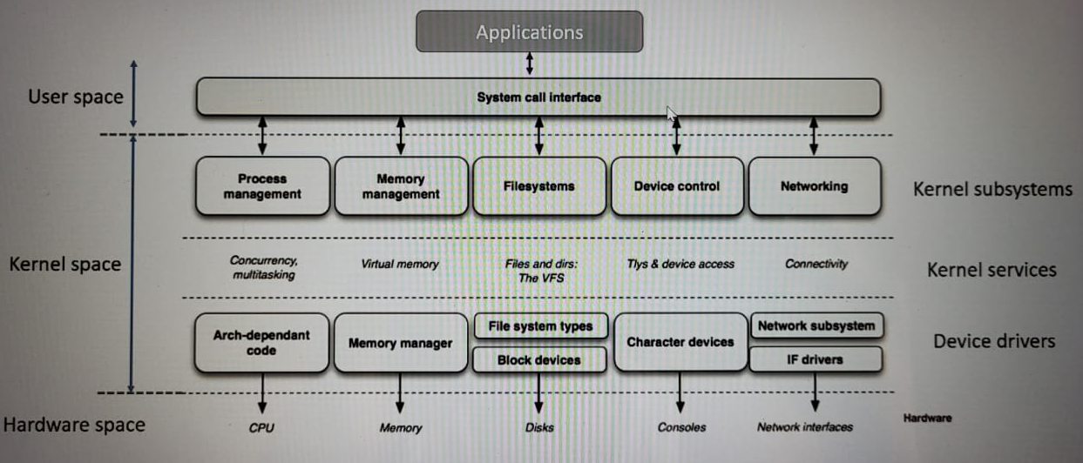
Block Diagram of the System
Figure 1. System block Diagram

Slide 5
Work done in Review - I
Understanding the Linux Device Driver model and Kernel Modules–
What is LKM and how is it useful?
User and Kernel Space - SystemCalls
Types of LKM – Character, Block and Network drivers
Developing a “Hello World” LKM –
Syntax of LKM : __init and __exit macro
Use of Makefile and Concept of Device Tree
Inserting the LKM dynamically into Linux Kernel – insmod and rmmod commands

Slide 6
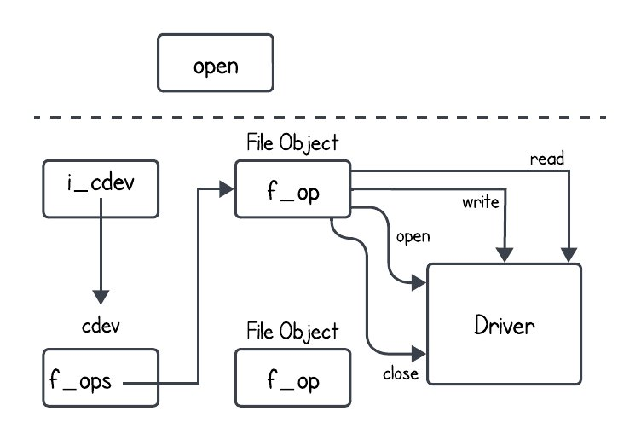
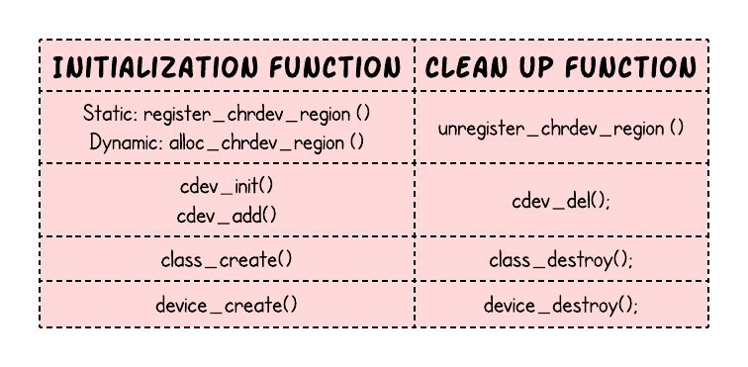
Continued..
Implementation of a Character Device Driver –
Pseudo-character driver implementation – Device registration, Major and Minor numbers
File Operations on Character driver using VFS – read, write seeking, etc.
Fig 2. Kernel Functions Involved
Fig 3. Pictorial representation how the flow goes​

Slide 7
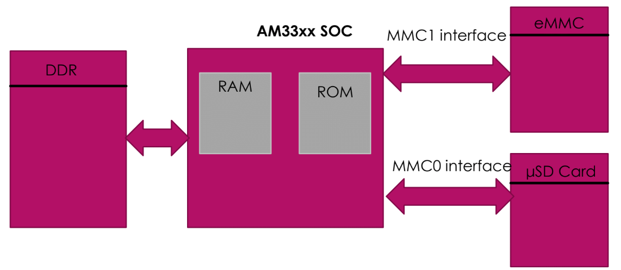
Work done in Review –II
Host(PC) and Target (Beaglebone)Setup –
Tool chain installation and ts PATH setting – gcc-linaro-7.50-x86_64_arm-linux-gnueabihf
Setting up the serial debug setup – FTDI converter
Understanding the Boot Sequence of BBB – boot switch (MMC0 or MMC1 interface)
Preparing SD card for SD boot – copying boot image(FAT16) and kernel image(ext4) to SD card

Slide 8
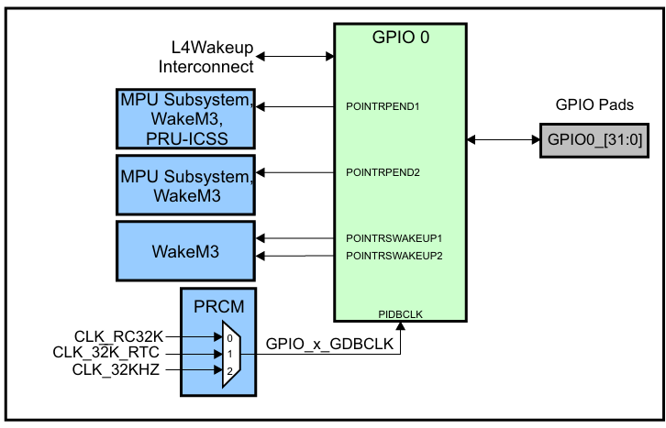
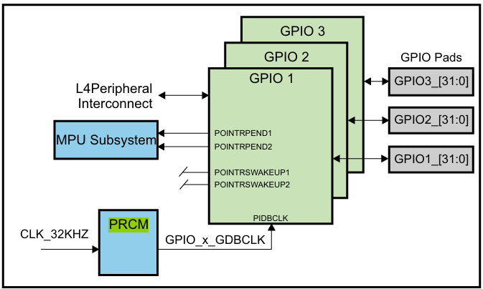
Continue..
Configuring the Eclipse IDE for application and driver development –
Adding toolchain PATH for cross-compilation
Installing Remote System Explorer – after the binary of the application file for BBB is generated, remotely through SSH the binary is transferred to BBB hardware.
Understanding the GPIO and I2C subsystem of the BBB – AM335x SOC, 4 GPIOs modules with 32pins each and 3 I2C peripherals.
Fig 4. GPIO Module Integration
Fig 5. GPIO[0-3] module Integration

Slide 9
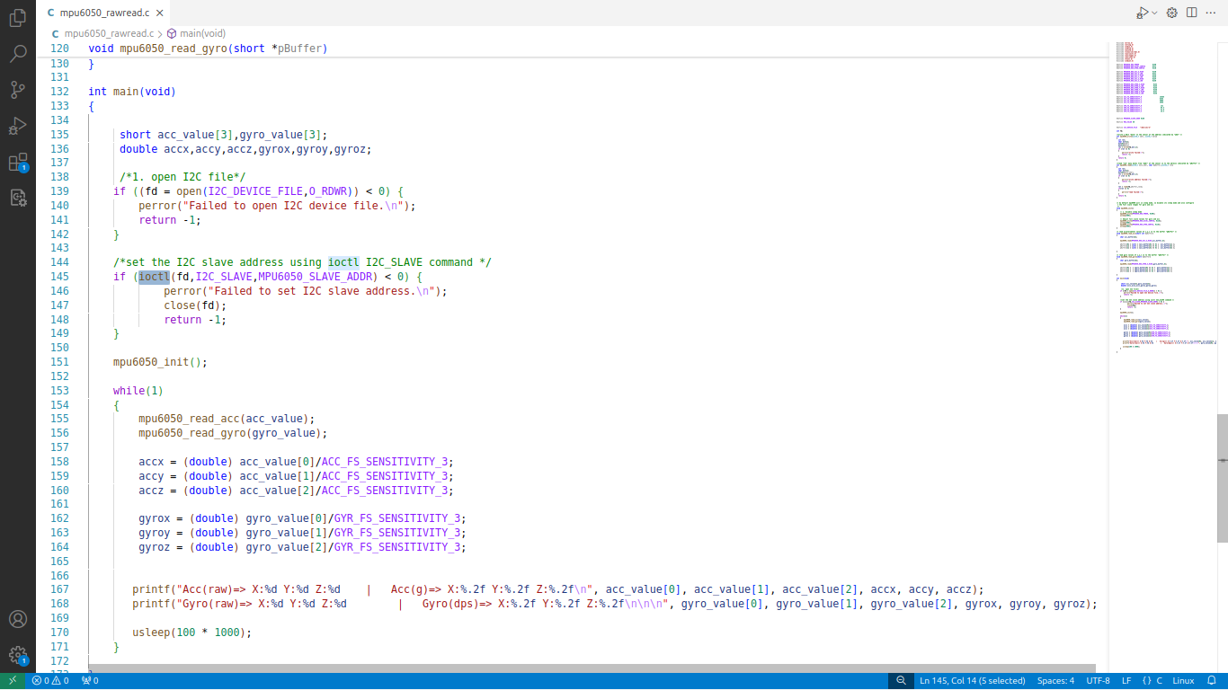
Continue..
Testing of GPIO and I2C Bus Driver for IMU (Developed an Applications with Kernel Space API) –
Already existing peripheral drivers for GPIO and I2C have been tested directly without the device driver of IMU.
This testing was done by developing the application knowing the kernel APIs to interact with I2C and GPIO hardware at user space.

Slide 10
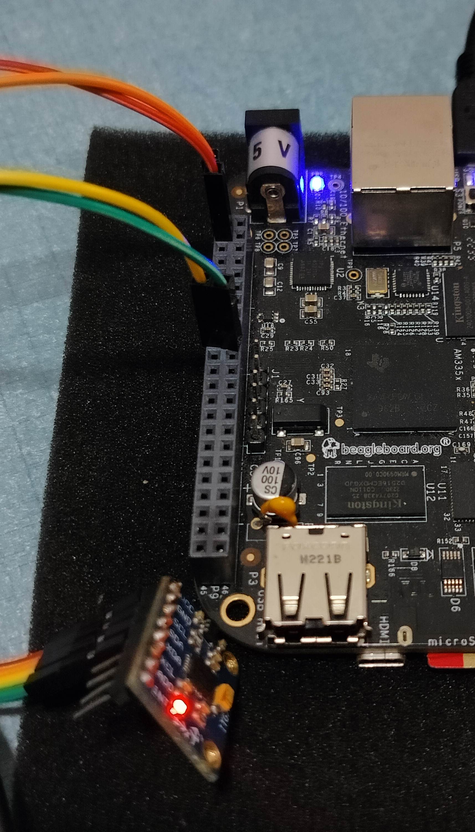
Work done for Final Review:
Hardware Implementation and User space Application
Main Controller: Beagle Bone Black
IMU (Inertial Measurement Unit): MPU6050 6 Axis Sensor (3 axis accelerometer, 3 axis gyroscope)
Communication Protocol: I2C (Inter Integrated Circuit)
Availability: 2xI2C supported(check with command : ls -l /dev/i2c*): i2c-1 and i2c-2
Use: I2C-2 use (p9-19 & p920 GPIO pin default set to the i2c-2)

Slide 11
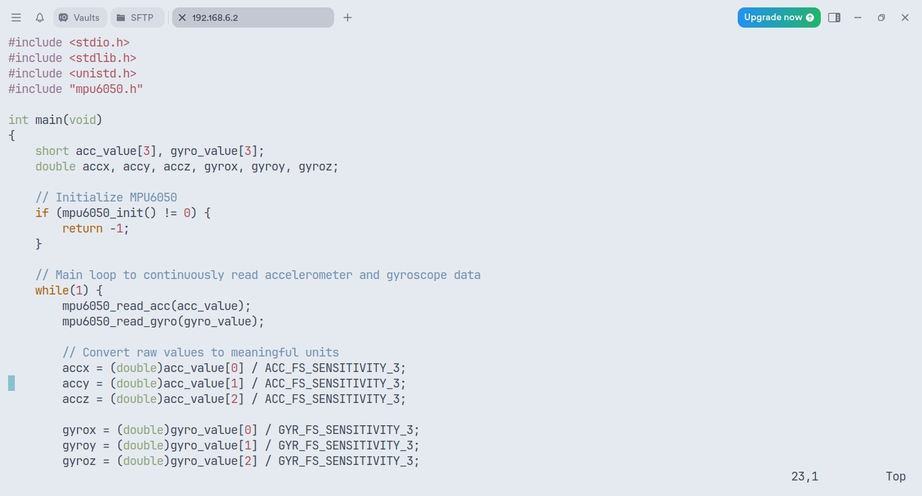
Software Application Implementation

Slide 12
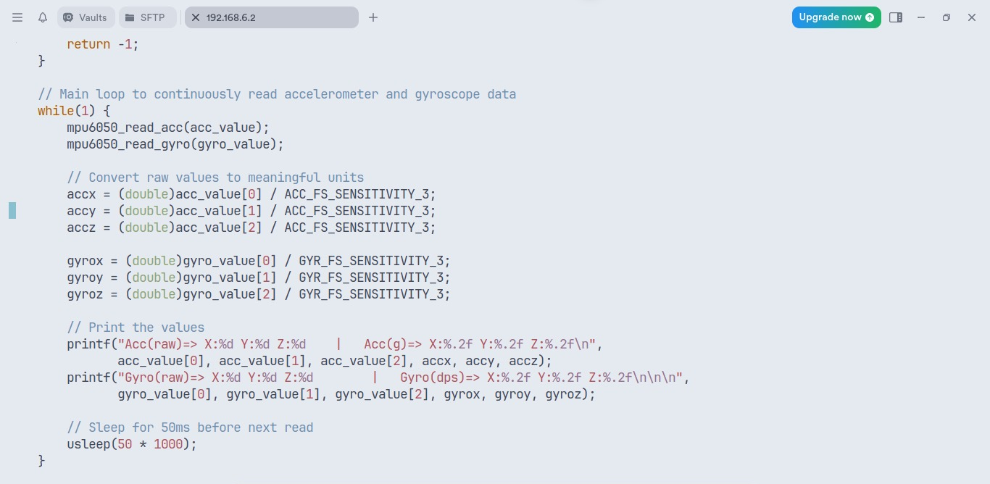
Continued

Slide 13
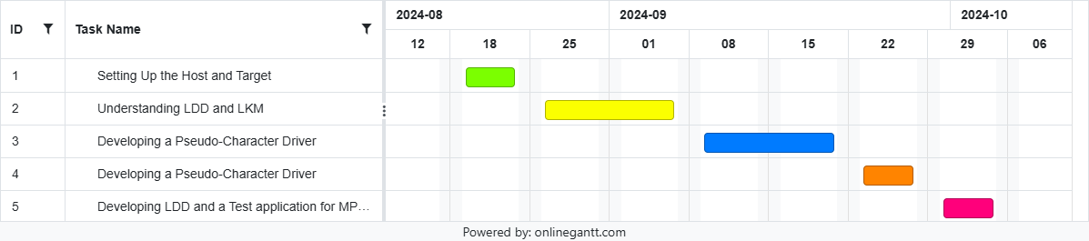
Gantt Chart

Slide 14
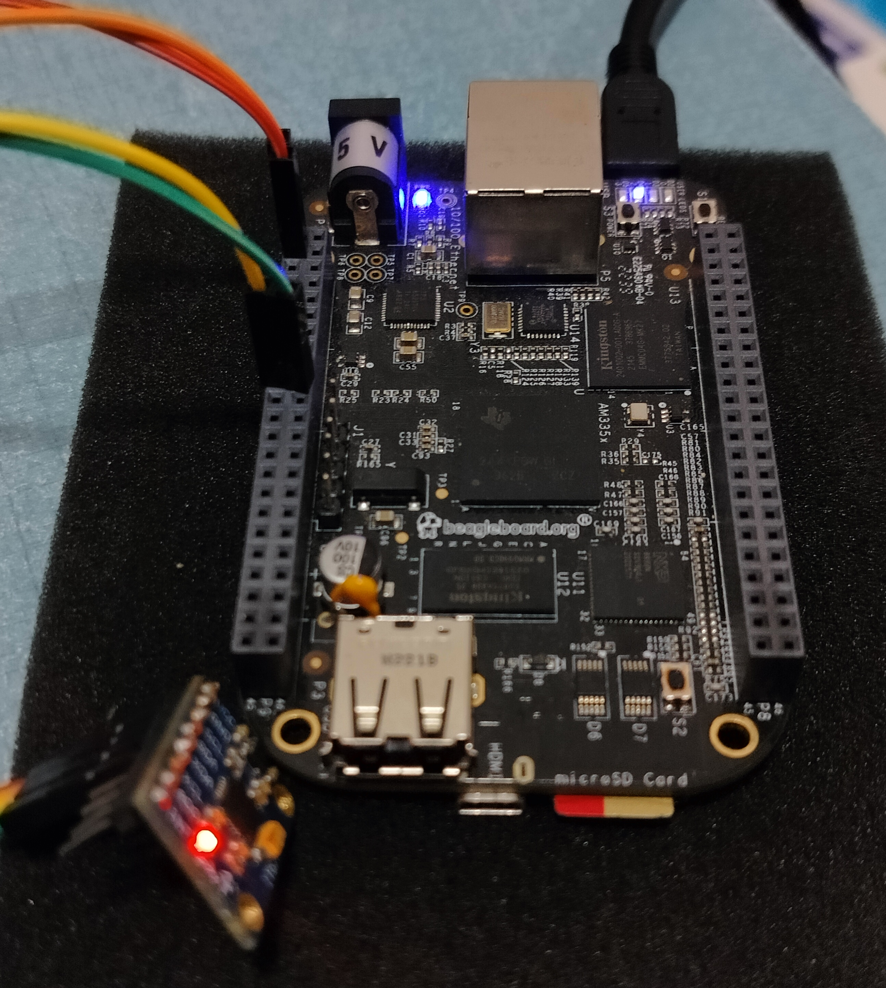
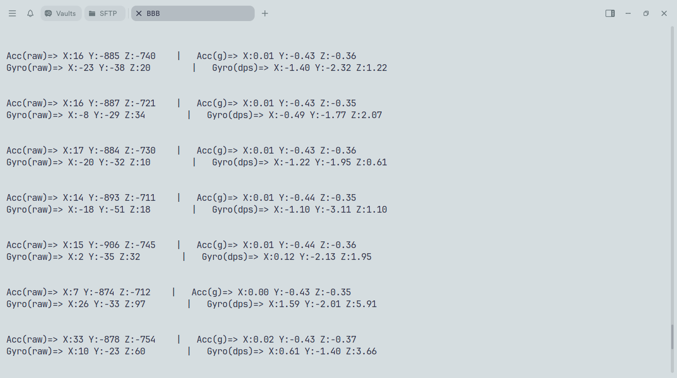
RESULTS

Slide 15


